Slide 1
Screening For Chronic Kidney Disease
Sheethal Sridhar

Slide 2


Data Preparation

Slide 3
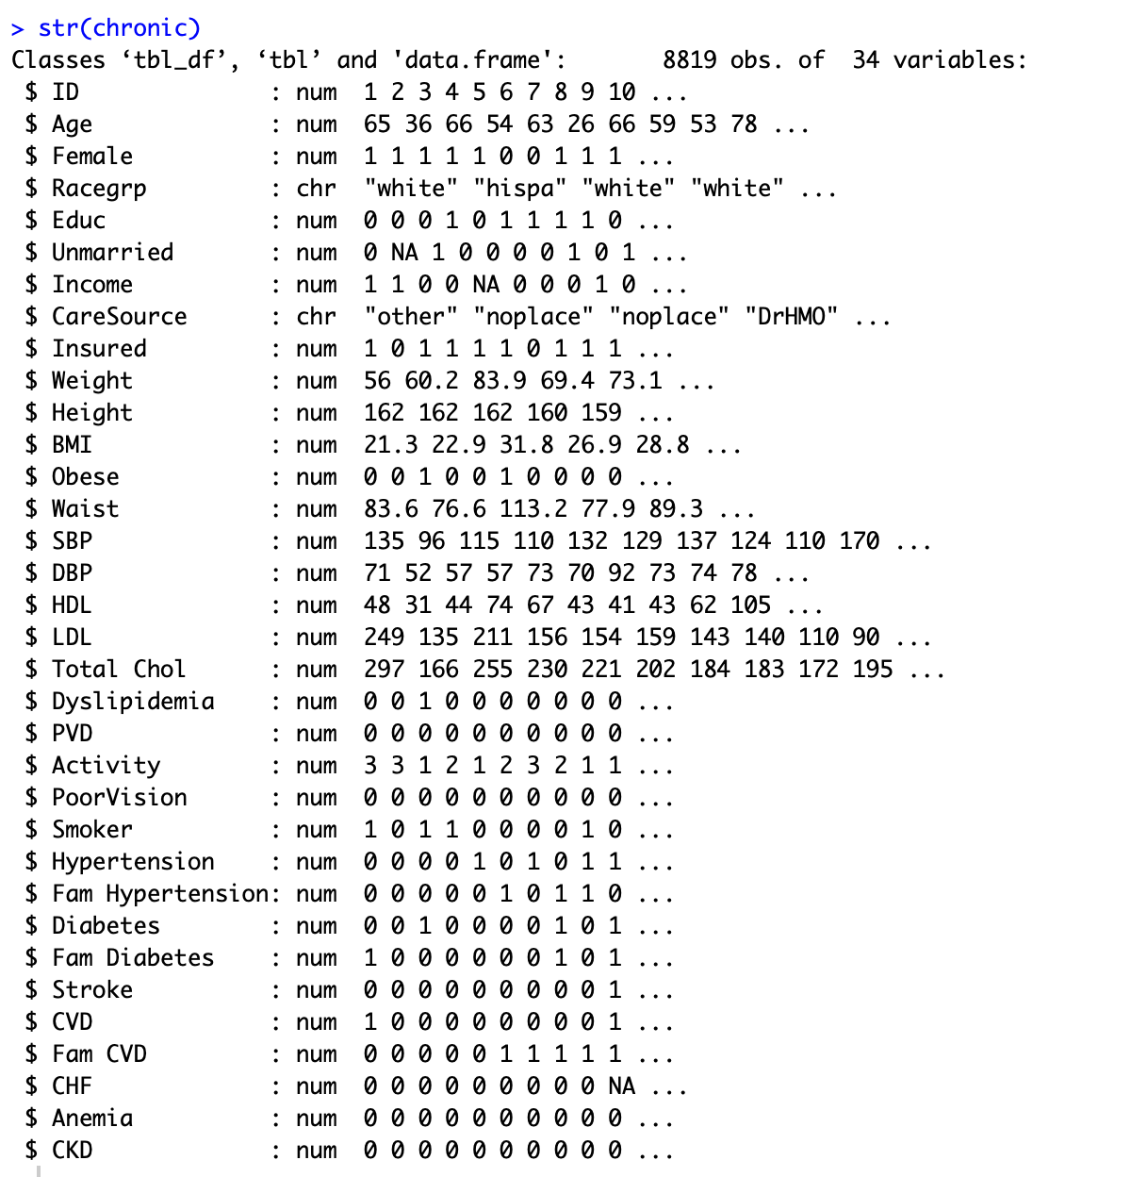
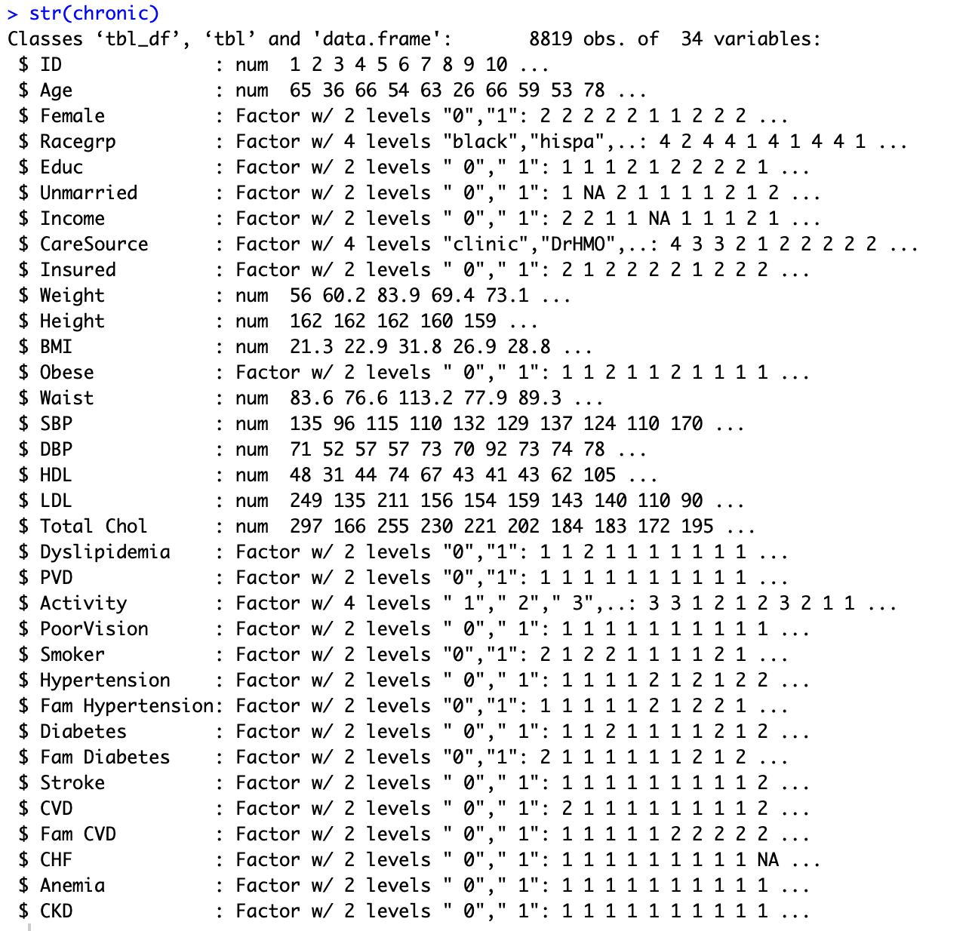
Changing the data types

Slide 4
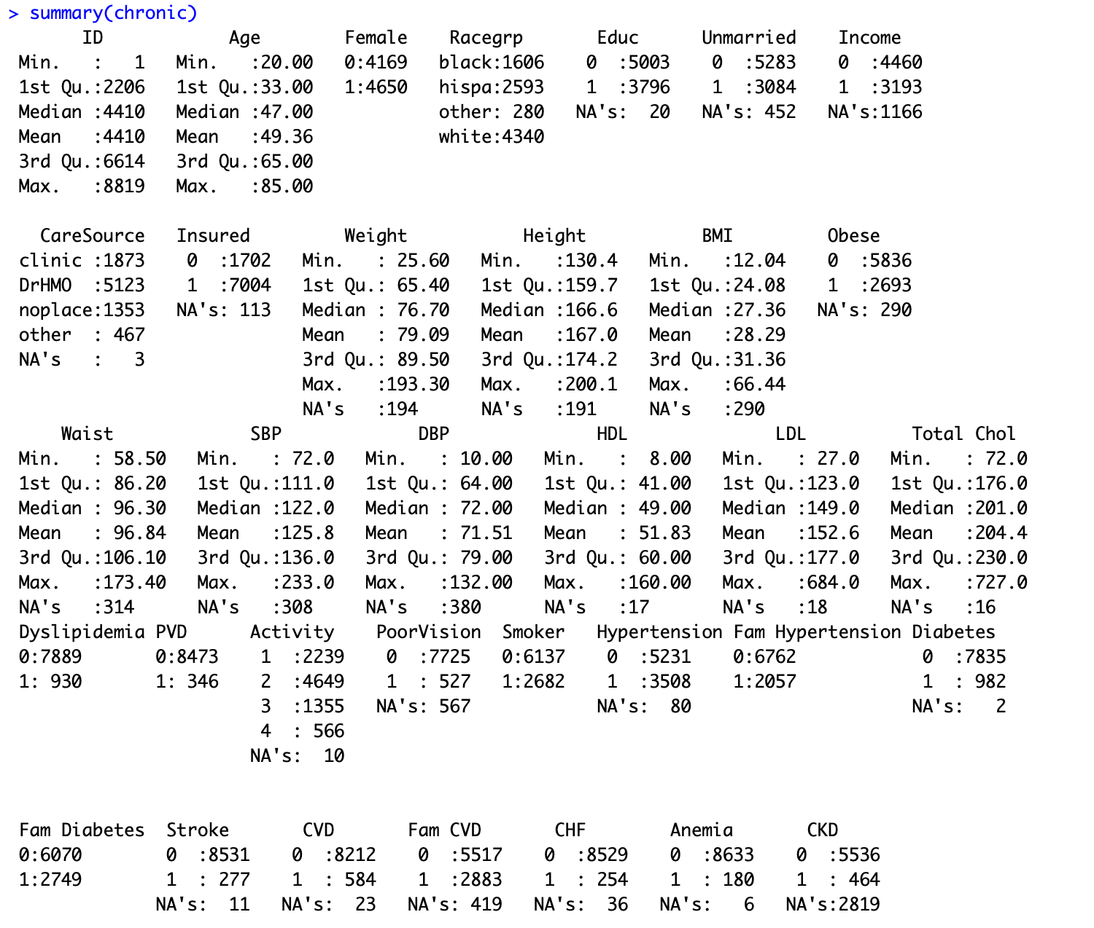

Descriptive statistics
Data has NAs in variables like Income, Poor Vision, DBP, Unmarried, Educ, CareSource, Insured, Weight, Height, BMI, Waist etc
Nas have been removed for all variables in model1 and in model 2 Nas have been removed from only those variables which were significant after evaluating model1.
Splitting of training(cp1) and test(cp2) data.

Slide 5
univariate analysis

Slide 6
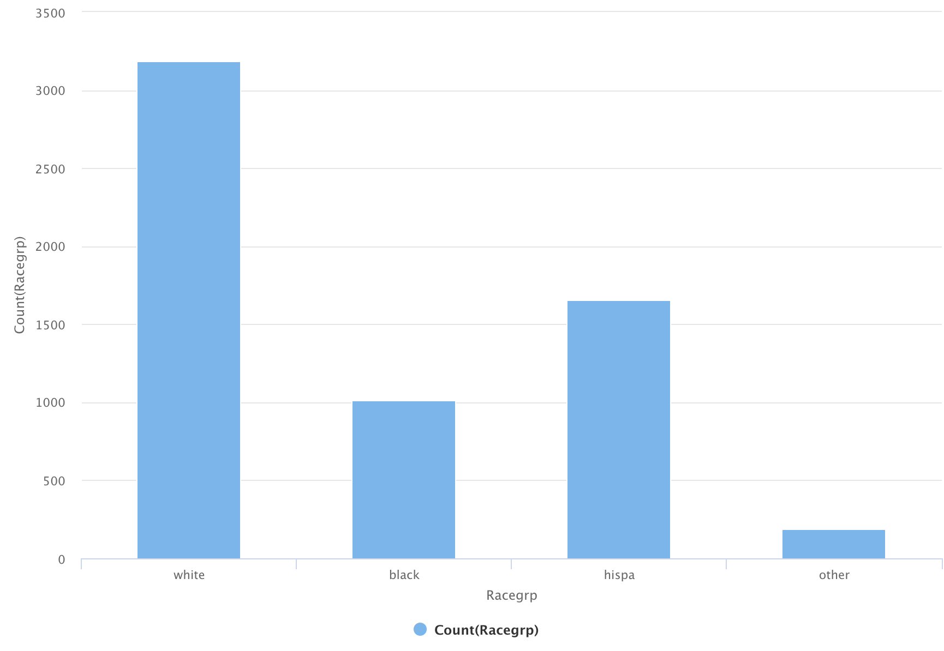
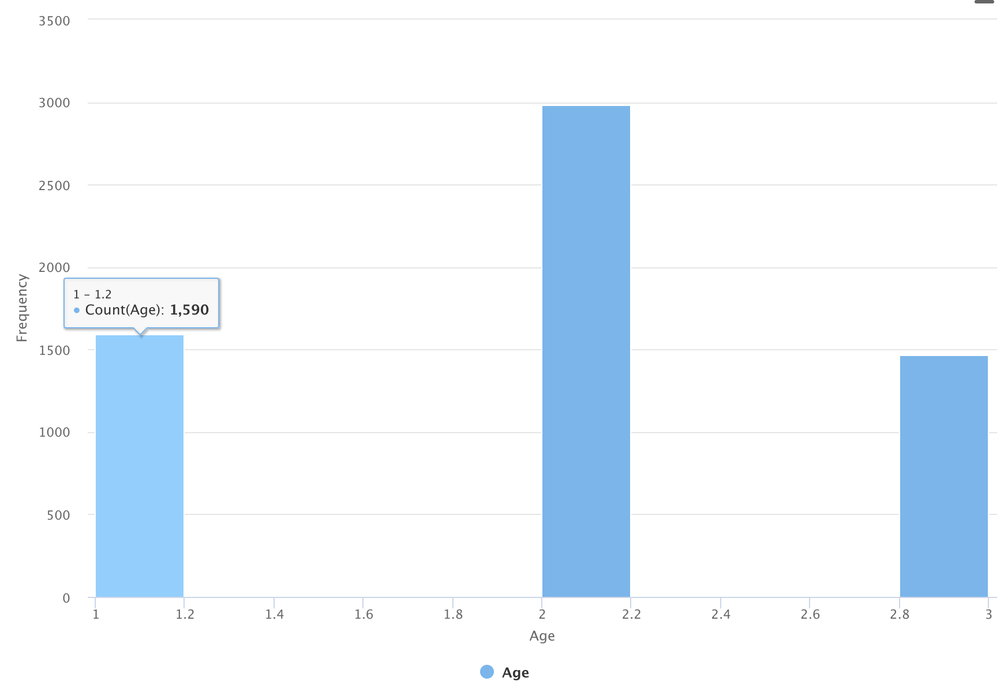
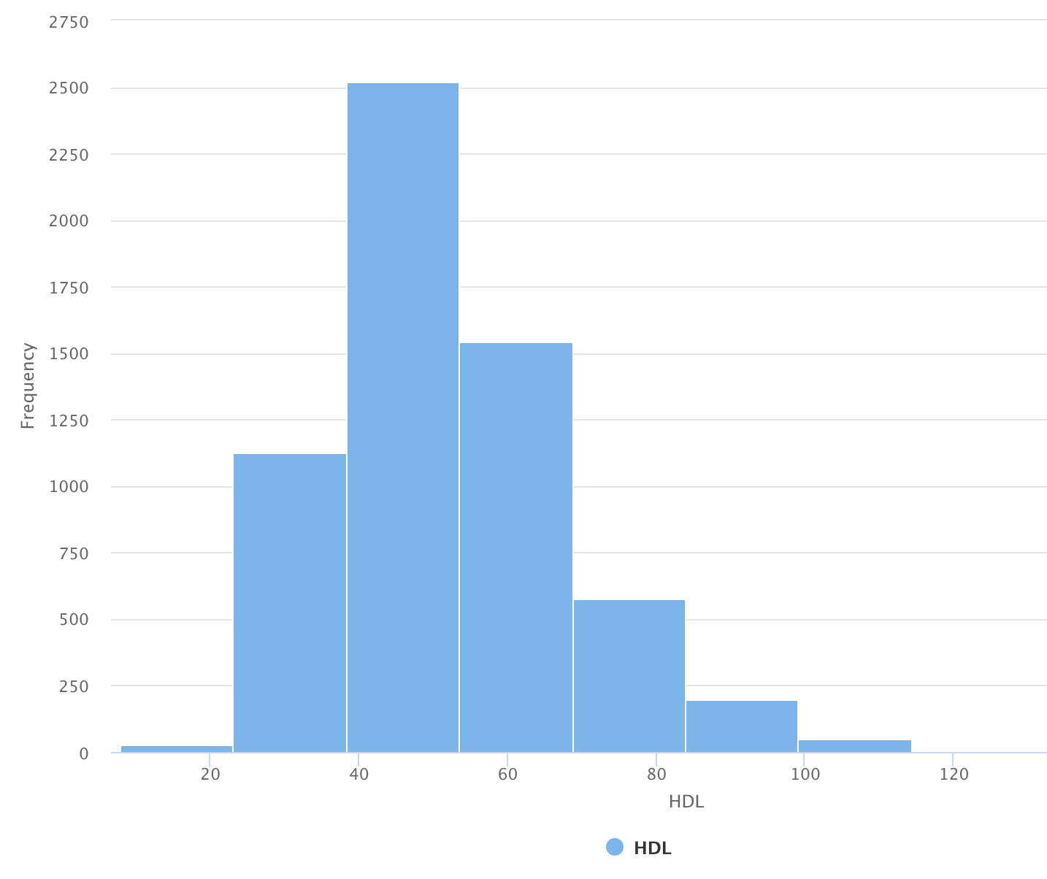
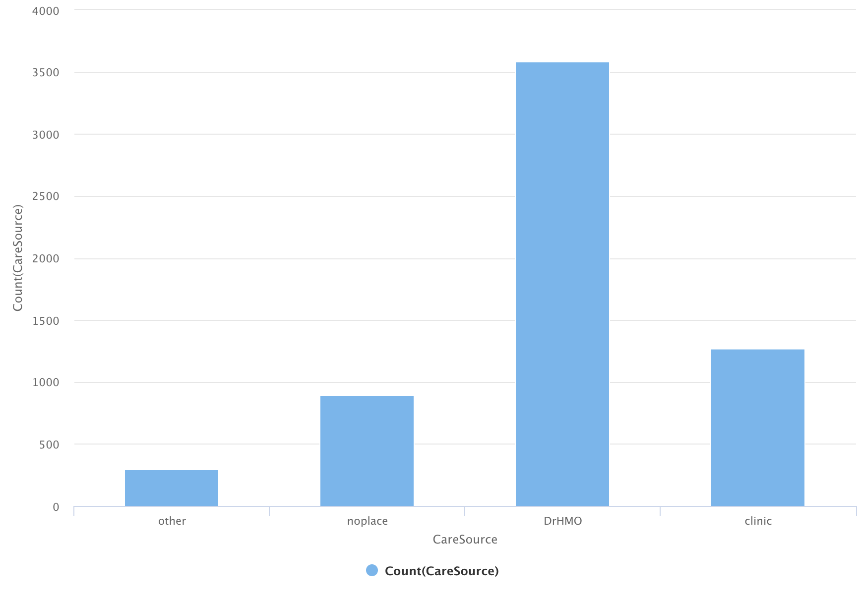
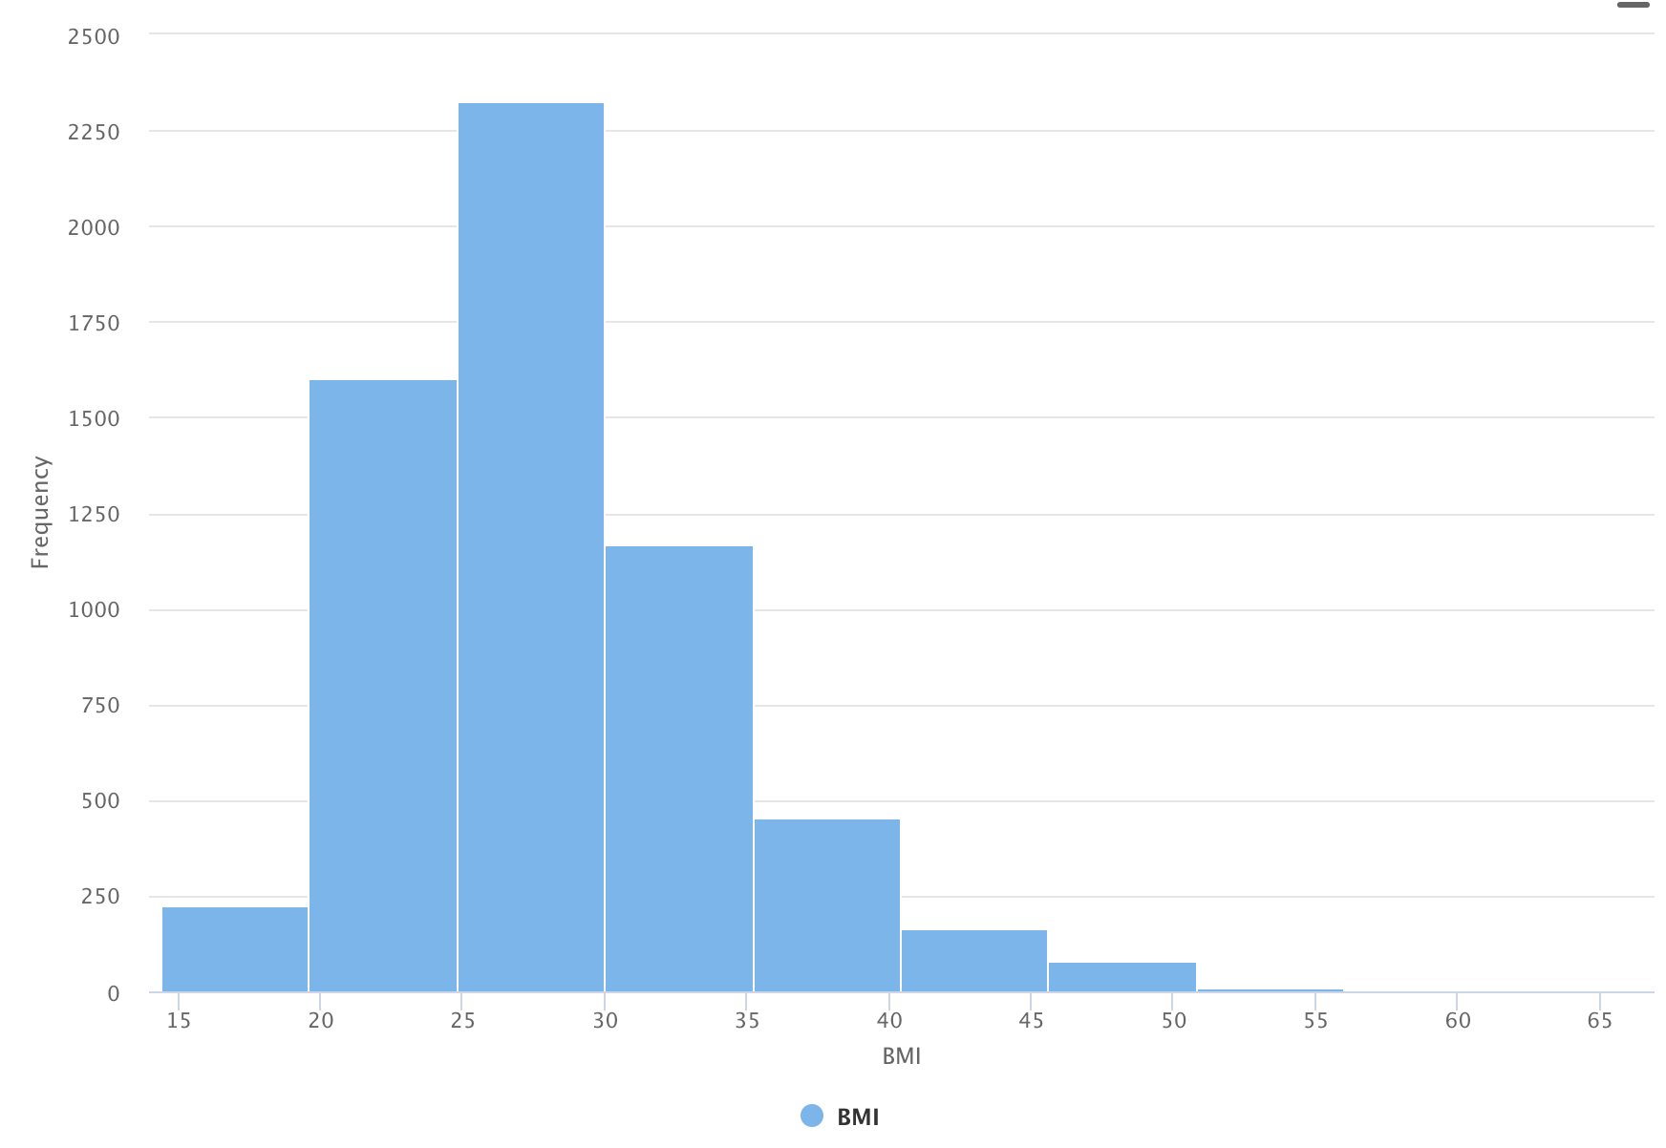
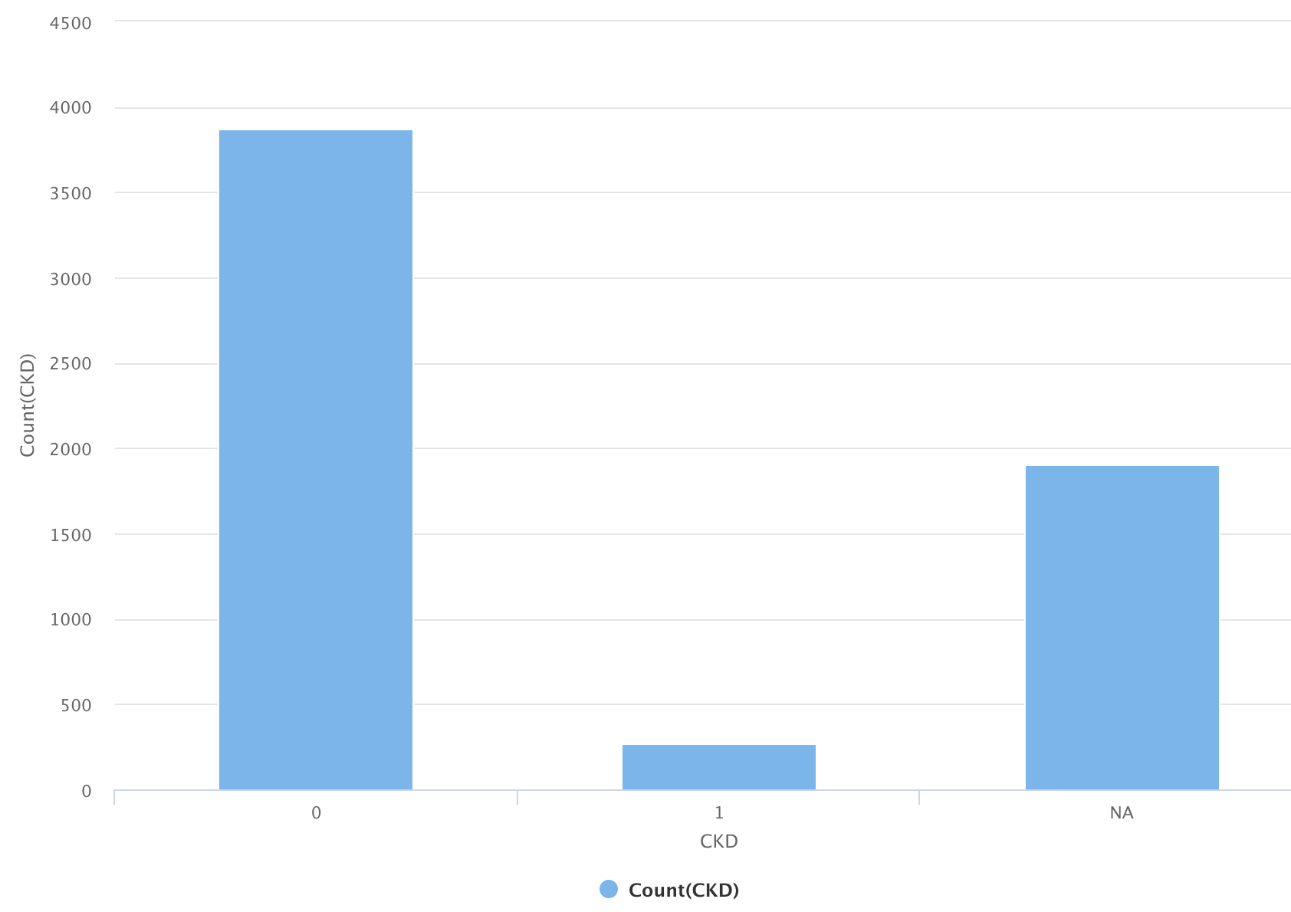
Univariate analysis

Slide 7
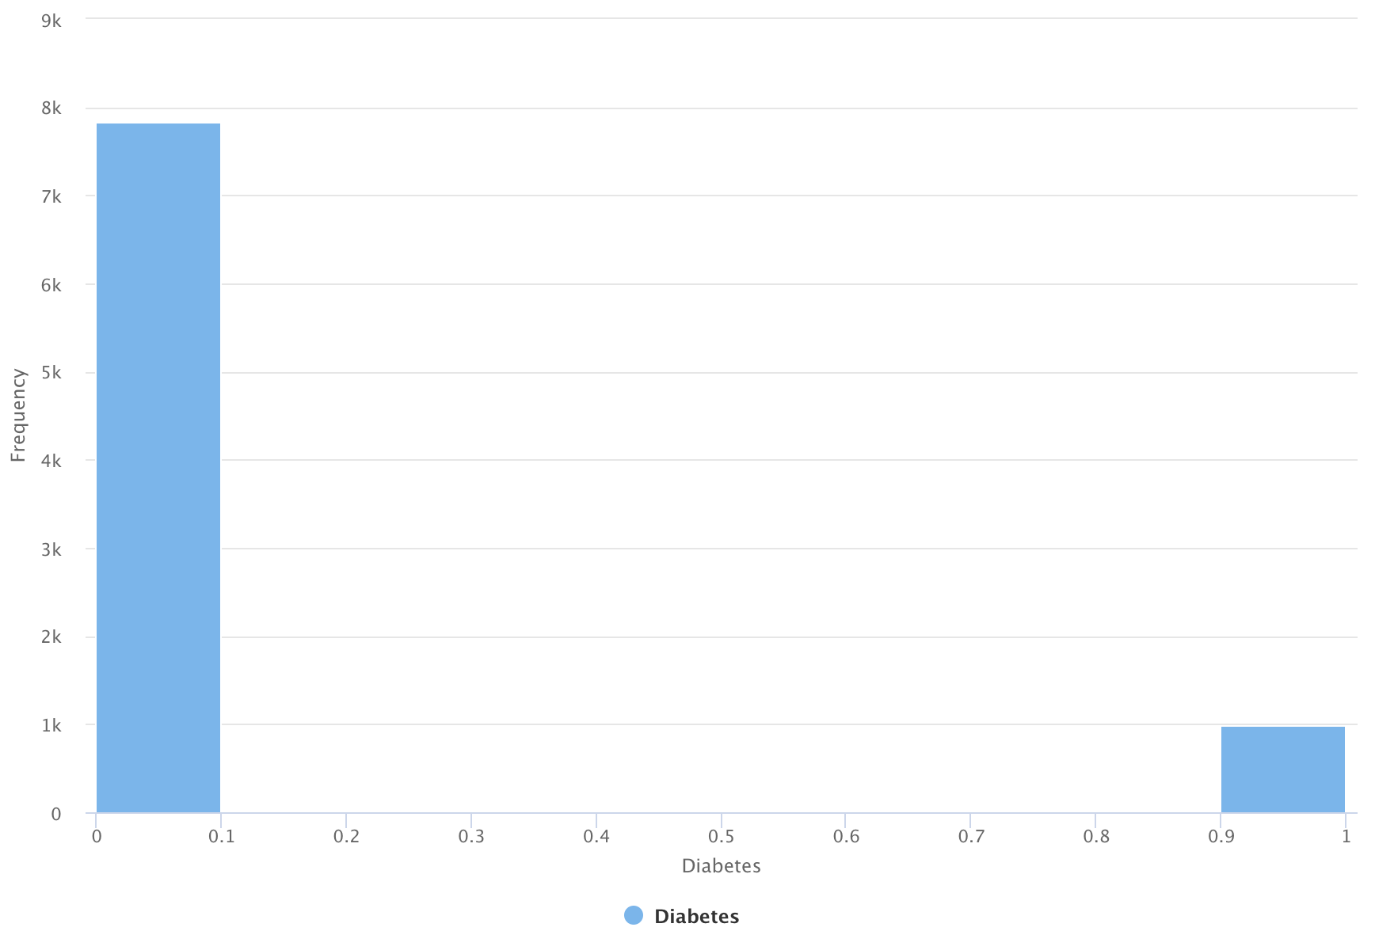
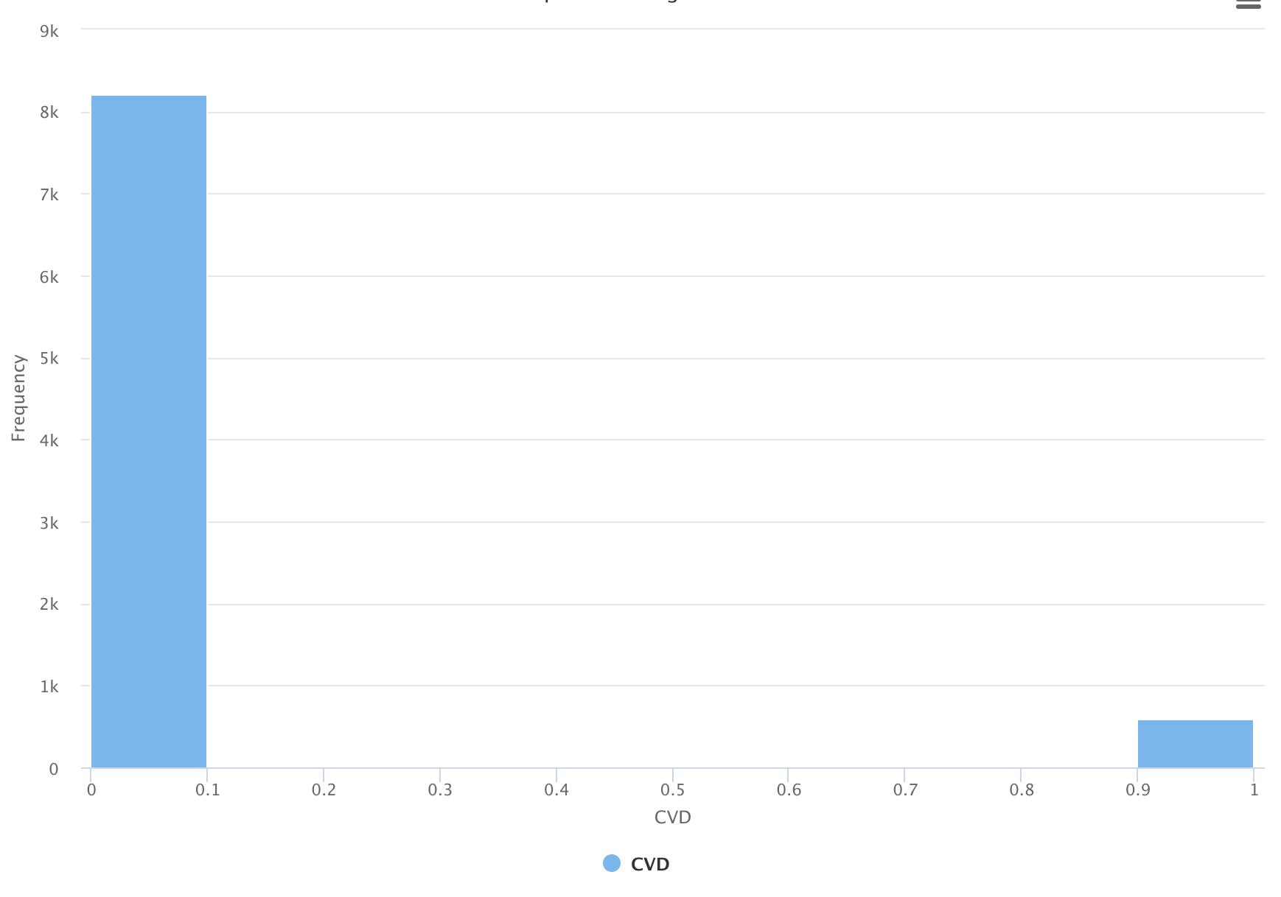
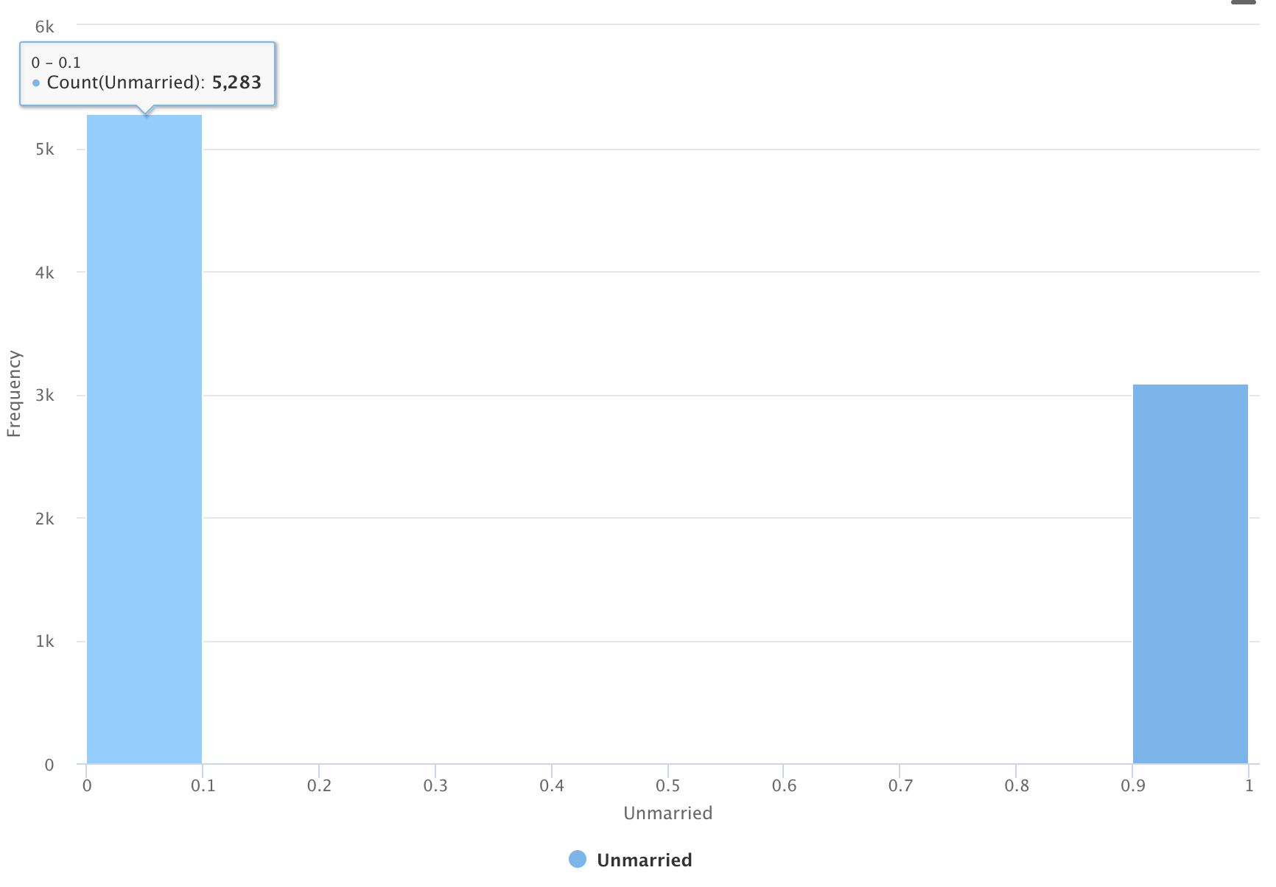
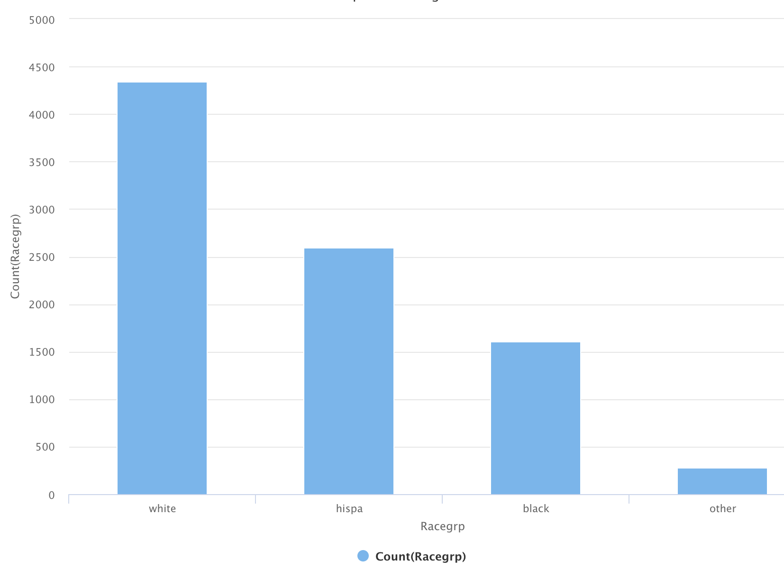
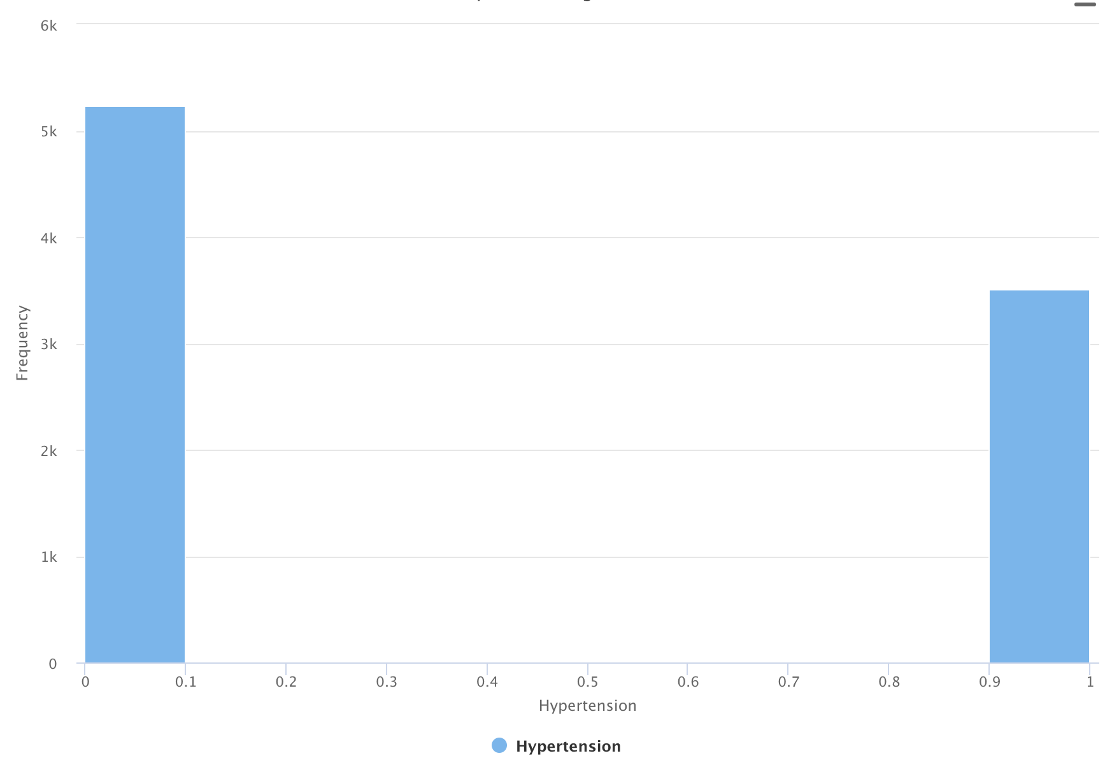
Univariate analysis

Slide 8
testing

Slide 9
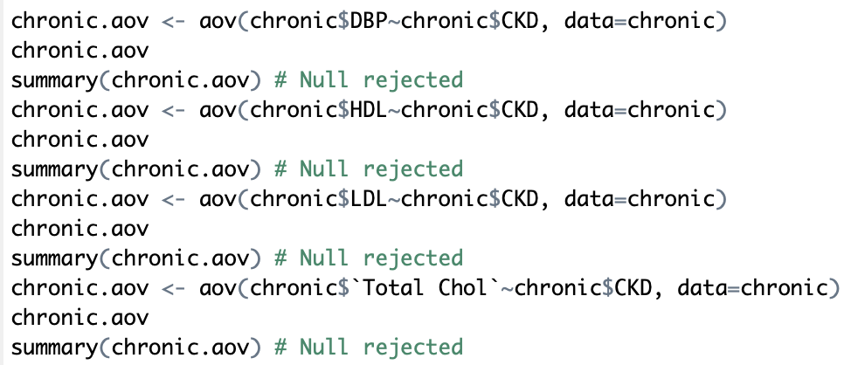
Anova testing results
Chi square testing results
Null Hypothesis Accepted for Height and BMI
Null Hypothesis Rejected for Age, Waist, SBP, DBP, HDL, LDL and Total Chol
Significant Variables: Education, Marital Status, Racegroup, Income, Care Source, Insurance, PVD, Activity, Poor Vision, Smoker, Hypertension etc
Insignificant Variables: Female, Obesity, Dyslipidemia and Fam Diabetes

Slide 10
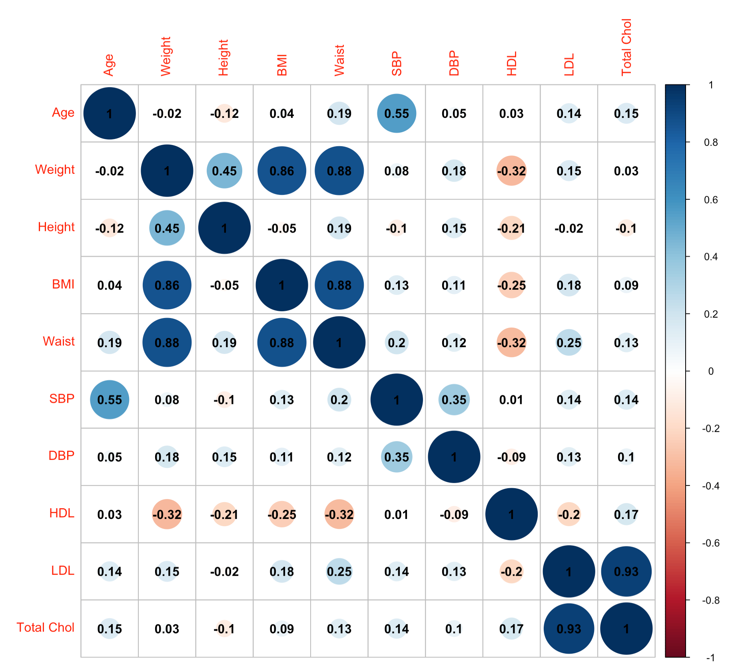
From the Correlation Matrix we see that BMI – Weight, Age-SBP, Weight-Waist, HDL-Total Chol are highly corelated
Thus keeping one among the co related variables would give us good results

Slide 11
modeling

Slide 12
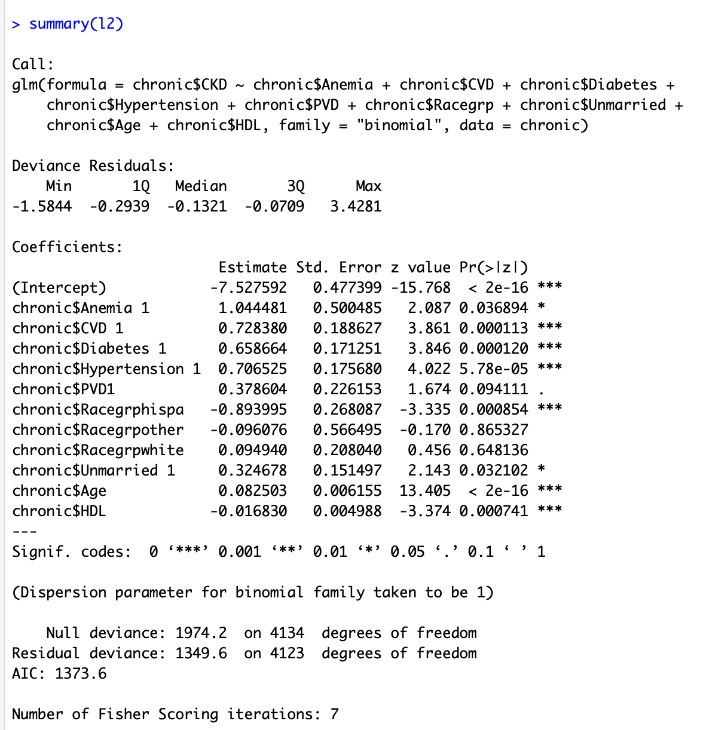
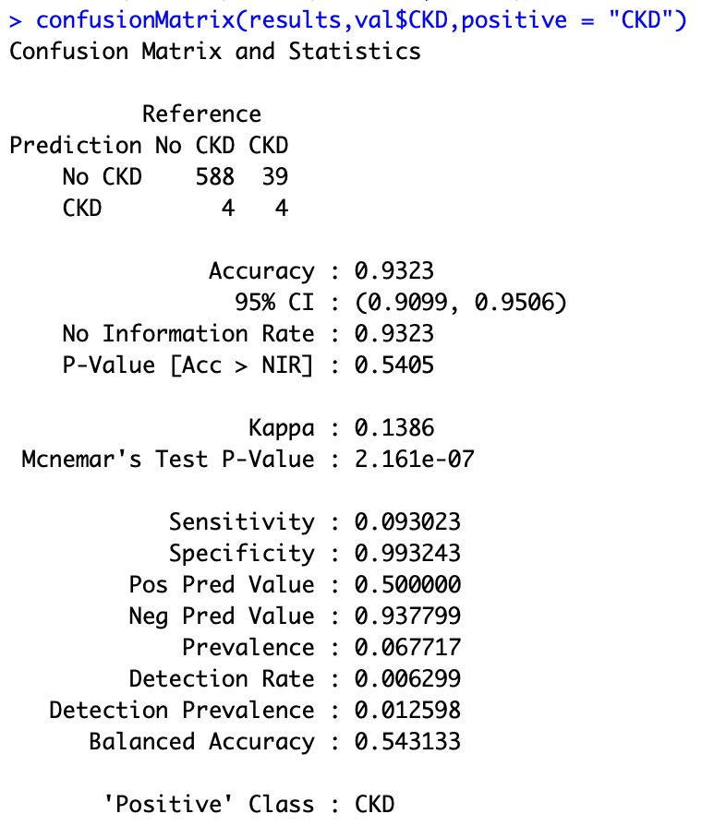
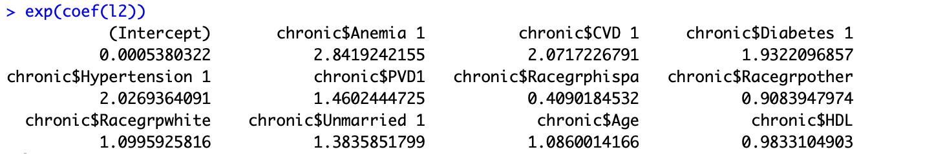
Logistic regression

Slide 13
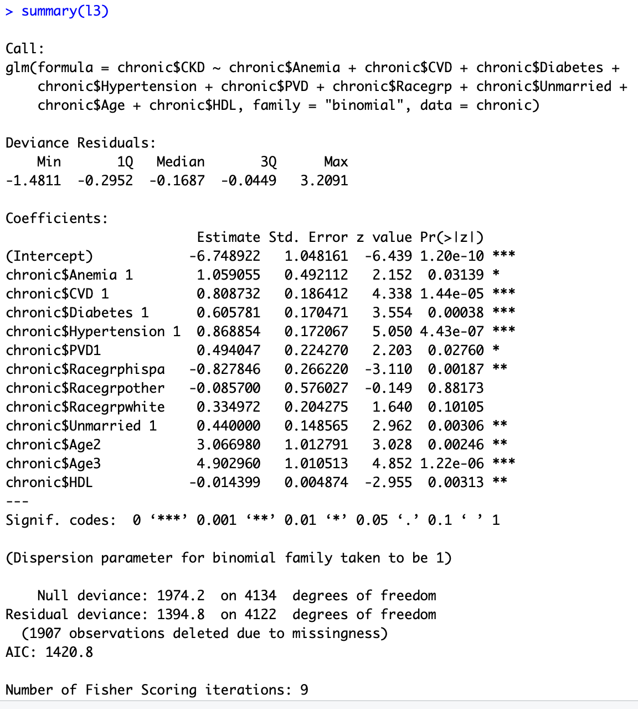
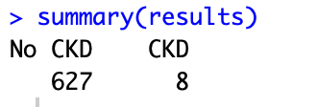
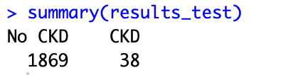
Predicting ckd of test data
People have a higher risk of getting a CKD if they have:
Hypertension
Cardio Vascular Diseases
Anemia
Diabetes
Peripheral Vascular Disease
High levels of HDL
Other characteristics:
People of age greater than 60 have a higher risk of CKD
People of the race Hispanic have the higher risk of CKD

Slide 14
Thank you

